Slide 1

SAP Analytics cloud training
Anurag Bajaj
Day 2

Slide 2
Agenda – Day 2
Introduction to BI
- Basics of BI and Steps used
- Understanding Data types
- Dimension v/s Measures
- The Account Dimension
- Data types in prediction
- Introduction to use case
---Break---
Demo Scenario – BI Scenario (Ann Jackson) – Hands On
- Create Data model – Type Analytic, Public, Acquired
- Create Story
- Create Responsive Page
- Add Charts – Numeric Point, Bar, Pie
- Add Panels with in Responsive page
- Input Controls – Measure, Dimension and Input Control
- Geo Map
- R Visualization
- Table Control
- Linked Analysis

Slide 3

What is BI and steps in BI
Requirements
Access Data
Prepare
Visualize
Share
BI Stands for Business Intelligence, it comprises the strategies and technologies used by enterprises for the data analysis on historic data for finding patterns and taking future decisions.
Discuss with end users
Articulate requirements
Plan for where will data come from
Conversions
Transformation
Enrichments
Wrangling and modeling
Collaboration with business
Feedbacks
Apply changes
Configure source
Analyze raw data
Bring data or use LIVE
Use widgets (map, chart, table)
Configure Dim / Measures
Apply formulas and cal
www.anubhavtrainings.com

Slide 4
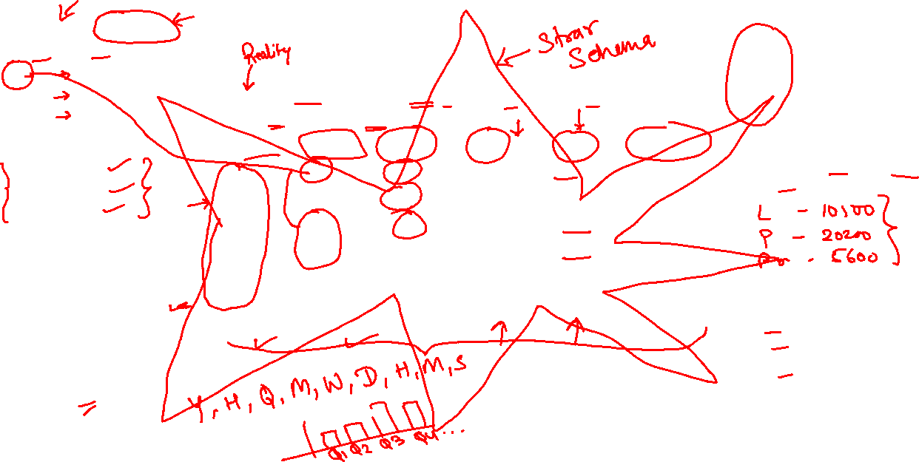
Understand Data Types – Dimensions & Measures
Master Data - Dimension
PID | Name
P1 | LAPTOP
P2 | PROJECTOR
P3 | PRINTER
CustomerID | Name
A | Apple
B | SAP
C | IBM
Fact or transaction data – KPI Key performance indicator
A Numeric field - measure
ORDID | CUST | PROD | QTY | AMT | COUNTRY
1 | A | P1 | 10 | 5000 | EUR
2 | B | P1 | 20 | 2500 | EUR
3 | A | P2 | 20 | 8500 | EUR
4 | A | P1 | 30 | 3600 | EUR
5 | B | P3 | 80 | 9500 | EUR
6 | B | P3 | 50 | 7500 | EUR
Which product was most selling one?
Apple 17100
SAP 19500
IBM 0
Total Qty, Total Amount
Country | Country
EU | Europe
US | USA
APJ | Asia
TIME
www.anubhavtrainings.com

Slide 5
Understand Data Types – Dimensions & Measures
Dimension Data – Master Data
Dimension Data – Master Data
Code | Name
C1 | SAP
C2 | IBM
C3 | Oracle
C4 | SF
C5 | Apple
Fact Table – Measures – KPI
Key performance indicator
Transaction Data
PID | Category
P1 | Laptop
P2 | SmartPhones
P3 | HDD
P4 | Pen Drive
P5 | CD ROM
www.anubhavtrainings.com

Slide 6
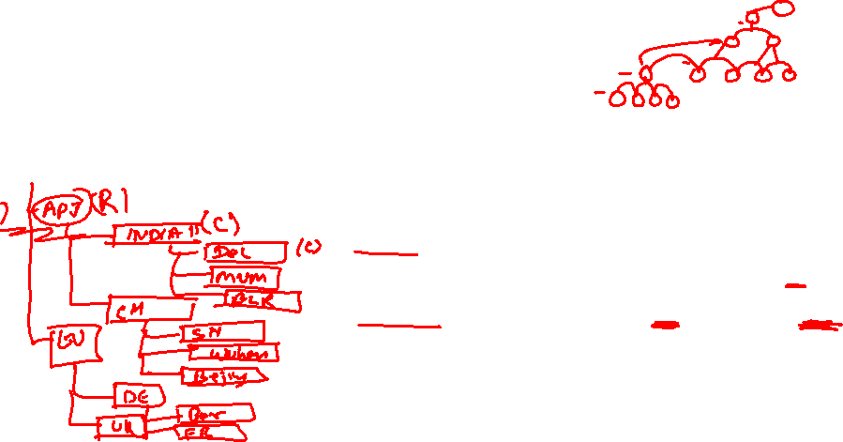
What is Account Dimension & Hierarchy?
All our measures in data combined together and make a special dimension called Account.
Account – Amount, Qty (together) - all measures (numeric)
In planning the definition of account dimension is a business entity.
Hierarchy
Is built by combining dimensions together which has some relationship of kind levels.
When dimensions make a Tree data structure together, its called hierarchy.
Level-based hierarchy – can have multiple levels e.g. Location, product, customer….More than 2 columns makes hierarchy.
Parent-child hierarchy (level 1) – Only 2 columns, you can make parent child e.g. employee-manager
www.anubhavtrainings.com

Slide 7
Prediction – Types of Data Types
Data Types
Categorial
(Dimensions)
Continuous
(Measures)
Nominal
Ordinal
Interval
Ratio
Discrete values
e.g. customer
CUS1, CUS20
Follows an order
Month
Weeks
Days
We can add and subtract but cant multiply, NO TRUE Zero
Temperature
0
All arithmetic's allowed
Absolute 0
Gross Amount, Qty
www.anubhavtrainings.com

Slide 8
Use Case 1
The Mobility Company
Story is a dashboard. Where we keep multiple pages and each page contains multiple widgets.
Story
Widgets
Controls
Widgets
Controls
Pages
Responsive | Canvas | Grid Page
Widgets
Controls
Widgets
Controls
Widgets
Controls
Model
Data File
Dataset
Blank Model
www.anubhavtrainings.com

Slide 9
What is Model
Models are the data foundation in analytics cloud, they are used to hold the data and also perform data transformation and wrangling. They are used for stories.
Types of models in SAC
Embedded V/S Public
Analytics (BI) V/S Planning
Acquired V/S LIVE
Classic V/S New
www.anubhavtrainings.com

Slide 10
Model Types
Embedded V/s Public
Embedded Models are used ONLY and ONLY by one story where we embed it
Public model are stored in SAC folders and can be used by any story
Analytic V/s Planning
Analytics model also known as BI Model and these are used to create BI Stories. However planning models are special models used for planning only scenarios.
Most of the models are BI Models = All measures are combined to name Account Dim
A planning model has following mandatory – Account, Time, optionally we have Category (Versioning data) and Org Dimension
Acquired v/s Live
Acquired – All the data is loaded inside SAC source could be a file or acquired source like SAP system or Google drive
Live – Data is fetched at runtime, Model is created as just a skeleton. Trial – BW, HANA
www.anubhavtrainings.com

Slide 11










Model Types
Classic V/s New Model
A classic data model have mandatory Account dimension, it will combine all the measure together.
A new model is like database table of BW system where it is not mandatory to combine to an account dimension.
www.anubhavtrainings.com

Slide 12


































































Slide 13
Types of filters
Page filter – Applies only to current page
Story Filter – Entire story
www.anubhavtrainings.com

Slide 14
Standard Practice
The pre-requisite to make sure that our design is a good dashboard with accuracy, it depends on input data.
In case the data has anomalies (blank, errors) You can use data wrangling to correct it but remember that we should ask the source to correct as much as possible.
https://www.rdocumentation.org/packages/wordcloud/versions/2.6/topics/wordcloud
www.anubhavtrainings.com

Slide 15
End of Day 2

Slide 16

Questions

Slide 17



We’re committed to empower you to be
#FutureReady
through powerful training solutions.
We build the workforce of the future.
250+
Corporate Clients
30,000+
Learners Trained
25000+
Learners Placed
FREE WEBINARS
Sign up for free webinars with industry experts every fortnight!
Enroll Now!
Contact us today!
www.anubhavtrainings.com

Slide 18

Anurag Bajaj
anurag.bajaj02@gmail.com

